Slide 1
COC ROLES AND RESPONSIBILITIES
Regional Team Training #2: June 15 & 16, 2022

Slide 2
Housekeeping
A recording of the training and the slides will be sent to all registered participant.
You should be hearing audio by now! Let us know in the Chat box if you can’t and someone will help you.
Audio is available through your computer speakers.
To join the webinar via the phone, please call in using:
Phone Number: 1-415-655-0002
Access code: 2422 281 1439
Please type your questions in the Chat box.

Slide 3
Welcome and Introductions
East Coast Presenters
Alissa Parrish (she/her) - ICF
Michael Thomas (he/him) - ICF
Thuan Huynh (he/him) - Abt Associates
Whitney Patterson (she/her) - Abt Associates
West Coast Presenters
Alissa Parrish (she/her) - ICF
Ashley Barker Tolman Shuler (she/her) - Cloudburst
Dusty Olson (she/her) Abt Associates
Gillian Morshedi (she/her) - Homebase
Technical Support - Trew Crocker (she/her) - Abt Associates

Slide 4
Agenda and Objectives
By the end of the training you will understand:
CoC Governing Board
Collaborative Applicant
HMIS Lead
CoC Membership and Committees
Best Practices
CoC Resources

Slide 5
CoC Roles
Governing Board
Collaborative Applicant
HMIS Lead
Membership
CoC Committees
CoC Staff
Persons with Lived Experience

Slide 6
GOVERNING BOARD

Slide 7
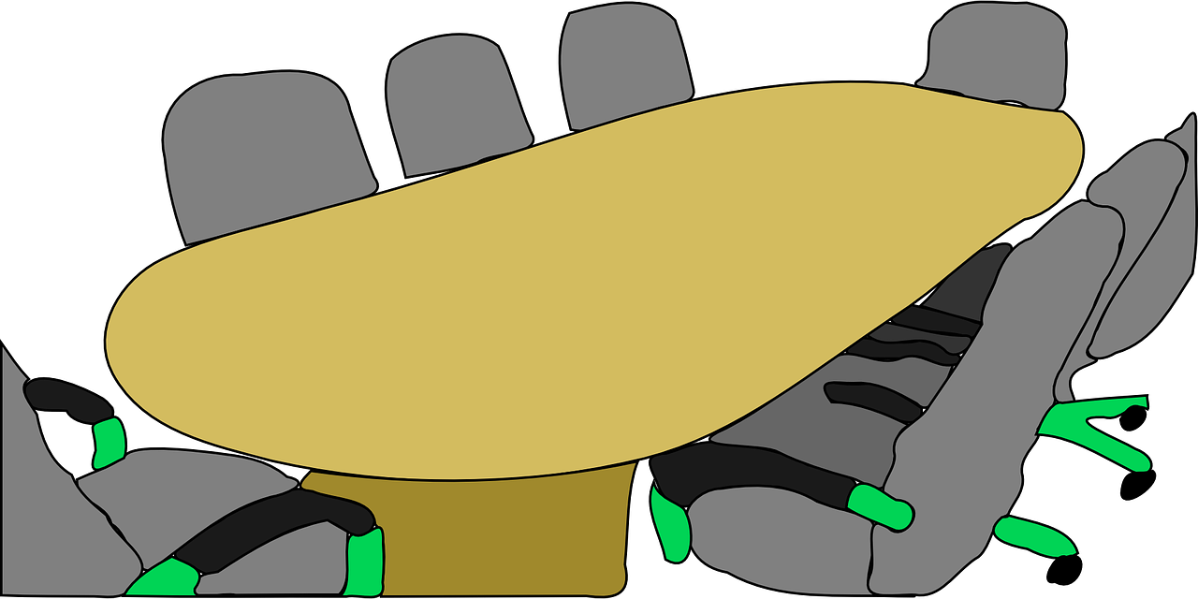
CoC Board- In General
Must be established by CoC to act on its behalf.
What the CoC means by “on its behalf” must be specified in the CoC governance charter.
The Board has no responsibilities except those designated and/or authorized in the governance charter
The Board is a subset of the CoC. Part of the larger whole, which is meant to be representative for all.
HUD does not prescribe how the responsibilities of the CoC are carried out

Slide 8
CoC Board - Responsibilities
The CoC Board is the main decision-making body for the CoC
Oversees all the work of the CoC
Governs, but much of the work happens through Committees/Workgroups
Approves written standards for CoC/ESG programs
Approves ranked list of CoC project applications
Approves CoC policy and procedures for coordinated entry
Establishes Committees and workgroups
Sets CoC goals and/or priorities
Committees will create the targets to achieve the goal

Slide 9
CoC Board - Selection of Members
Must be representative of relevant organizations and of projects serving homeless subpopulations
Must include at least one individual who is currently or has previously experienced homelessness
Members must be selected using a process defined in writing, including term limits
Written process must be reviewed, updated and approved by the CoC at least once every 5 years
Representation should be inclusive and consistent with community demographics and population of persons experiencing homelessness within the community

Slide 10
Annual Governance Charter Review
Governance charter must be:
Developed in consultation with the Collaborative Applicant and HMIS Lead
Reviewed and updated annually
Adopted by full CoC membership at least every five years

Slide 11
Evaluation of System
Homeless Response
Coordinated Entry
Collaborative Applicant
HMIS Software Solution
HMIS Lead

Slide 12
Conflict of Interest
Members must follow code of conduct, conflict of interest, and recusal process
Conflict of interest should be outlined in the Governance Charter
Providers who sit on the CoC board should recuse themselves from the CoC funding decisions and NOFO process
All board members should sign a conflict of interest policy outlining these expectations, declaring any and all conflicts

Slide 13
COLLABORATIVE APPLICANT

Slide 14
Collaborative Applicant
Unless granted additional responsibilities by the CoC that are documented in the governance charter, the collaborative applicant’s sole responsibility is to:
Compile and submit the annual application to HUD for CoC Program funds
Apply for CoC Planning funds on behalf of the CoC
Can serve as lead agency for staff support of all CoC functions

Slide 15
CoC Application
Responsibilities of the collaborative applicant:
Prepares and submit the CoC Consolidated Application to HUD as part of the competition
Applies for the planning grant on behalf of the CoC.

Slide 16
Planning Grant
The collaborative applicant is the only applicant permitted to apply for CoC planning funds. May be used for:
Designing and carrying out the collaborative process for the application to HUD
Preparing and submitting the CoC’s application for CoC Program funds
Determining the geographic area the CoC will serve
Evaluating outcomes of projects funded through CoC and ESG program grants within the geographic area
Participating in the Consolidated Plan(s) process of the jurisdictions within the geographic area
Developing a CoC system
Conducting sheltered and unsheltered Point-in-Time counts
Monitoring recipients and subrecipients and enforcing compliance with program requirements
Notes:
e-snaps : CoC Program Applications and Grants Management System - HUD Exchange
https://www.hudexchange.info/programs/e-snaps/
CoC Planning Project Application Resources for CoC Program - HUD Exchange
https://www.hudexchange.info/resource/2913/coc-planning-project-application-instructional-guide/

Slide 17
Unified Funding Agency
To be designated as the Unified Funding Agency (UFA) for the Continuum of Care, the Continuum must select the collaborative applicant to apply to HUD to be designated as the UFA for the Continuum. HUD will consider these criteria when deciding whether to designate a collaborative applicant a UFA:
The Continuum of Care it represents meets the requirements on the Interim Rule;
The collaborative applicant has financial management systems that meet the standards set forth in 24 CFR 84.21 (for nonprofit organizations) and 24 CFR 85.20 (for States);
The collaborative applicant demonstrates the ability to monitor subrecipients; and
Such other criteria as HUD may establish by NOFO.
If approved, the UFA may then apply for the CoC planning funds as well as additional UFA costs.
Notes:
e-snaps : CoC Program Applications and Grants Management System - HUD Exchange
https://www.hudexchange.info/programs/e-snaps/
UFA Costs Project Application Resources for the CoC Program - HUD Exchange
https://www.hudexchange.info/resource/3438/ufa-costs-instructional-guide/

Slide 18
HMIS LEAD

Slide 19
HMIS Lead Role
The entity which manages a CoC's Homeless Management
Information System (HMIS) on behalf of the CoC. While the CoC retains ultimate authority and responsibility for HMIS, the HMIS
Lead is generally responsible for HMIS implementation which includes:
Administration
Management
Operation
Provide end user training
Meet reporting requirements for funders
Notes:
HMIS Lead Series - HUD Exchange
https://www.hudexchange.info/resource/6261/hmis-lead-series/

Slide 20
HMIS Costs
HMIS Lead may also use CoC funds to pay the costs of:
Hosting and maintaining HMIS software or data;
Backing up, recovering, or repairing HMIS software or data;
Upgrading, customizing, and enhancing the HMIS;
Integrating and warehousing data, including development of a data warehouse for use in aggregating data from subrecipients using multiple software systems
Administering the system;
Reporting to providers, the Continuum of Care, and HUD
Conducting training on using the system, including traveling to the training
Notes:
HMIS Lead Series - HUD Exchange
https://www.hudexchange.info/resource/6261/hmis-lead-series/

Slide 21
Data Quality
Refers to the reliability and validity of client-level data collected in the HMIS
Measured by the extent to which the client data in the system reflects actual information in the real world
Determined by assessing certain characteristics such as timeliness, completeness, consistency, and accuracy
In order to assess data quality, a community must first think about what data quality means and document this understanding in a data quality plan
Notes:
Data Quality Management Program: https://files.hudexchange.info/resources/documents/HMIS-Data-Quality-Management-Program.pdf

Slide 22
Privacy
While data sharing is often necessary to provide efficient and effective housing and services, improper release or use of data may jeopardize the privacy, or even the safety, of the people who place their trust in the homelessness system of care. As such, HMIS Leads should ensure the privacy of client-level information.
HMIS Lead creates the privacy plan related to HMIS data in conjunction with CoC data leadership.
Meet all minimum baseline requirements laid out in the HUD Data and Technical Standards of 2004, Section 4.2 and should include or reference CoC established privacy policies and procedures.
Include standards for agency compliance, references to HMIS Policies and Procedures, references to HMIS Participating Agency and HMIS End User Agreements, and either include or be included in a monitoring process
Clearly state what entities and individuals have access to HMIS, protections to ensure privacy of client information, policies and procedures for client access and correction to their data, and protocols for use of data related to privacy
Notes:
2004 Data and Technical Standards: https://www.hudexchange.info/resource/1318/2004-hmis-data-and-technical-standards-final-notice/
Chapter 2 of CE Management and Data Guide: https://files.hudexchange.info/resources/documents/coordinated-entry-management-and-data-guide.pdf
HMIS Lead Series: HMIS Lead Standards (hudexchange.info)
https://files.hudexchange.info/resources/documents/HMIS-Lead-Standards.pdf

Slide 23
Security
The HMIS Lead should ensure that the HMIS Policies and Procedures include provisions related to security that establish, at a minimum:
CoC expectations for system and data security
Responsibility for system and client data security
System and data access classifications and descriptions
Technical safeguards, such as user authentication, virus and firewall requirements, and physical access to systems and workstations accessing the HMIS and its data, including requirements for updating security software
A series of policies and procedures to ensure the physical security of the HMIS and any devices used to access the HMIS
A requirement for compliance to security policies and procedures included in HMIS Agency Participation Agreements, HMIS End User Agreements (including HMIS Lead staff), and any data release agreements
Notes:
HMIS Lead Series: HMIS Lead Standards (hudexchange.info)
https://files.hudexchange.info/resources/documents/HMIS-Lead-Standards.pdf

Slide 24
Participation & Compliance Monitoring
The Interim Rule requires the CoC to “ensure consistent participation of recipients and subrecipients in the HMIS.”
The HMIS Lead should assist the CoC with developing an appropriate plan for monitoring the records and data collection practices of participating agencies
A clear and transparent monitoring plan should include:
References to compliance policies, procedures, and benchmarks, including those included in agreements
Processes for conducting a monitoring
A tool for conducting compliance monitoring
Schedules for periodic monitoring
Methods for communicating monitoring results to the Covered Homeless Organization (CHO) and the CoC
Notes:
HMIS Lead Series: HMIS Lead Standards (hudexchange.info)
https://files.hudexchange.info/resources/documents/HMIS-Lead-Standards.pdf

Slide 25
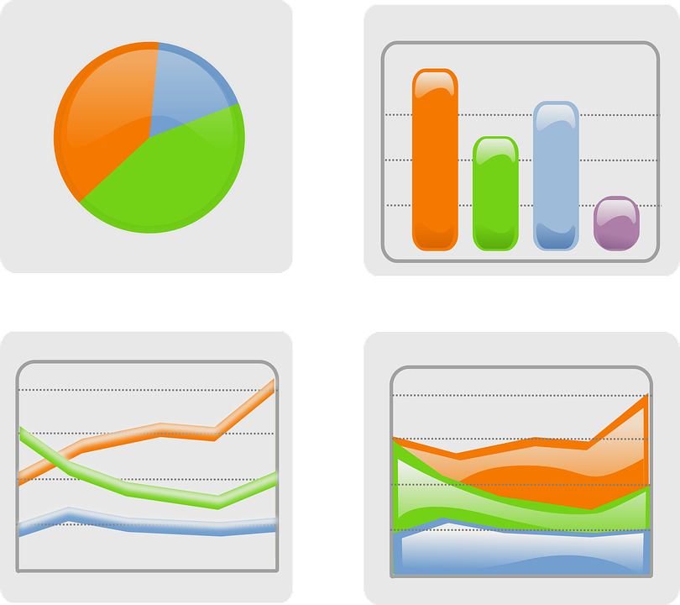
Data Reporting
HMIS Reporting should be a major driver of CoC decision-making, serving as a tool for:
understanding gaps in services
understanding community needs and the degree to which they are being met
understanding and addressing racial disparities
coordination between organizations
coordination of services to clients in a housing crisis
Notes:
HMIS Lead Series: HMIS Lead Standards (hudexchange.info)
https://files.hudexchange.info/resources/documents/HMIS-Lead-Standards.pdf

Slide 26
HMIS Reports
The HMIS Lead should ensure that HMIS can generate project-level reports required by HUD and other federal funding partners, including
HMIS Comma Separated Value (CSV) Exports for upload to (HUD) Sage Repository
Veterans Administration (VA) Supportive Services for Veteran Families (SSVF) Repository export
Health and Human Services (HHS) Runaway and Homeless Youth HMIS (RHY-HMIS) Repository export
Required progress reports and companion reports include: CoC Annual Performance Report (APR), ESG Consolidated Annual Performance & Evaluation Report (CAPER), Projects for Assistance in Transition from Homelessness (PATH) Annual Report, and Housing Opportunities for Persons With AIDS (HOPWA) APR.

Slide 27
System Performance Measures (SPM) - Overview
The HEARTH Act focuses on viewing the local homeless response as a coordinated system of homeless assistance options as opposed to homeless assistance programs and funding sources that operate independently in a community. The Act:
Requires communities to measure their performance as a coordinated system, in addition to analyzing performance by specific projects or project types
Established a set of selection criteria for HUD to use in awarding CoC funding in section 427 that require CoCs to report to HUD their system-level performance
Encourages CoCs, in coordination with ESG Program recipients and all other homeless assistance stakeholders in the community, to regularly measure their progress in meeting the needs of people experiencing homelessness in their community and to report this progress to HUD
Notes:
System Performance Measures Introductory Guide (hudexchange.info)
https://files.hudexchange.info/resources/documents/System-Performance-Measures-Introductory-Guide.pdf

Slide 28
System Performance Measures (SPM)
The Length of Time Persons Remain Homeless
The Extent to which Persons who Exit Homelessness to Permanent Housing Destinations Return to Homelessness
Number of Homeless Persons
Employment and Income Growth for Homeless Persons in CoC Program-funded Projects
Number of Persons who Become Homeless for the First Time
Homeless Prevention and Housing Placement of Persons Defined by Category 3 of HUD’s Homeless Definition in CoC Program-funded Projects (High Performing Communities Only)
Successful Placement from Street Outreach and Successful Placement in or Retention of Permanent Housing
Notes:
System Performance Measures Introductory Guide (hudexchange.info)
https://files.hudexchange.info/resources/documents/System-Performance-Measures-Introductory-Guide.pdf

Slide 29
COC MEMBERSHIP

Slide 30
Membership
Members should include:
Nonprofit homeless assistance providers
Victim service providers
Faith-based organizations
Governments
Businesses
Advocates
Public housing agencies
School districts
Social service providers
Mental health agencies
Hospitals
Universities
Affordable housing developers
Law enforcements
Organizations that serve veterans
Individuals experiencing and previously experiencing homelessness
A CoC is established by representatives of relevant organizations within a geographic area to carry out the responsibilities set forth in the CoC program interim rule.
Membership should demonstrate a community wide commitment to ending and preventing homelessness

Slide 31
COC COMMITTEES

Slide 32
CoC Committees
A good CoC has working groups or committees that manage the activities of the CoC in a diverse and structured manner.
Roles and responsibilities are clearly defined, and safeguards are in place to protect against potential conflicts of interest.
Committee and Working Group examples:
Governance committee
HMIS Governance
Lived experience committee
Project application rating and ranking
Provider Commission
Quality Improvement/ Performance evaluation
Additional committees, subcommittees, or work groups as needed

Slide 33
COC STAFF

Slide 34
Staff Responsibilities
Manage CoC calendar (full membership, CoC Board, committee meetings)
Support agenda development, email with attendees, record attendance, take notes, circulate to leaders for review, send out, schedule needed follow-up
Remain aware of changing HUD priorities and requirements, keep CoC and other partners informed, and facilitate community initiatives
Build and maintain relationships

Slide 35
PERSONS WITH LIVED EXPERIENCE OF HOMELESSNESS

Slide 36
CURRENT HUD EXPECTATIONS
CoC requirement: CoC Boards must include at least one individual currently or formerly experiencing homelessness (consumer)
In the 2021 NOFO, HUD incentivized communities with an opportunity for CoCs to enhance their NOFO application point totals by engaging with Persons with Lived Experience
Persons with lived experience must have experienced homelessness within the last 7 years or are currently program participants
Full points were available if there is more than one person engaged in local CoC planning and at least one person with lived experience came from an unsheltered situation

Slide 37
WORKING TOGETHER

Slide 39
How do the Roles fit Together?
Delegation of responsibilities - Authority may be delegated to the board, a committee, a workgroup, the collaborative applicant, the HMIS lead, or another applicable entity as determined by the CoC
Each community can define which entities make sense to take on responsibility for each of the obligations
Clear roles and responsibilities should be outlined in the governance charter and updated regularly
MOUs can further define the relationships between partners

Slide 40
Balance of State CoCs
Balance of State and statewide CoCs must be innovative in their leadership and governance structures to address their challenges around distance and geography.
Some Balance of State CoCs have developed a regional approach to make the governance of large rural areas more manageable.
Each region usually has its own governance structures, as well as defined roles on the overall CoC governing board.
While it requires ongoing efforts to maintain coordination, the regional approach enhances local buy-in, creates more tailored local responses to homelessness, reduces the burden on CoC staff, and ensures better geographic coverage of the CoC.
Balance of State CoCs can strengthen governance structures by people with influence representing a variety of sectors from various locations across the CoC.
Balance of State CoCs can intentionally create leadership pipelines to mitigate issues associated with limited professional staff and distance.
When staff capacity is limited, Balance of State CoCs can consider outsourcing responsibilities to third parties, such as consultants and technical assistance firms.

Slide 41
Rural CoCs
Creatively engage non-targeted systems and programs, faith-based organizations, and informal partners to address resource gaps
Partner with programs that serve low-income people, such as TANF, SSI, SSDI, Medicaid, Public Housing Agencies, and the workforce development system
Partner with behavioral health and healthcare systems
Develop outreach and engagement practices that reach people experiencing homelessness
Regionalize coverage
Build trust with non-traditional partners that encounter those experiencing homelessness, including law enforcement, medical providers, postal workers, employment agencies, park rangers, and local businesses
Implement coordinated entry processes that promote access for people across large and/or rural geographies
Engage key stakeholders from across the CoC, tailor the process to local needs, and build a robust network of referral sources
Think outside the box to expand availability of crisis beds and permanent housing opportunities
Provide crisis housing outside of typical emergency shelter settings
Increase access to affordable housing with resources such as HOME and USDA programs
Proactively develop landlord relationships and perform housing-focused outreach
Consider expanding shared housing opportunities
Notes:
Rural Homelessness - HUD Exchange
https://www.hudexchange.info/homelessness-assistance/rural/#strategies-for-addressing-rural-homelessness
https://www.usich.gov/tools-for-action/strengthening-systems-for-ending-rural-homelessness-promising-practices-and-considerations/

Slide 42
FACTORS FOR SUCCESS

Slide 43
System Performance Monitoring
Routine (quarterly or biannual) analysis of System Performance Measures helps communities understand how their system is functioning and if they have deployed the right combination of strategies and resources
Debrief with providers and review policies and procedures to investigate the extent to which project-level practices promote positive housing outcomes.
Debrief with persons experiencing homelessness to understand how the program experience is showing up in the performance data
Collaborate with a cross-section of community leaders and stakeholders to set short and long-term goals for system improvement and indicators of success
Develop a comprehensive performance management plan which includes performance goals, baseline data, benchmarks, improvement strategies, and timelines.

Slide 44
Diversity of CoC Board
Historically, homeless response systems have been predominantly established and led by white leadership
BIPOC communities are the most impacted by homelessness in every community
“Those closest to the problem are closest to the solution but furthest from the resources and the power”
They typically have the best understanding of the reality of our work to prevent and end homelessness – both in terms of the problems that exist and the knowledge of the services and interventions that are the most effective solutions.
Notes:
Racial inequities by the numbers: https://endhomelessness.org/resource/racial-inequalities-homelessness-numbers/
Data snapshot, racial disparities in homelessness: https://endhomelessness.org/resource/data-snapshot-racial-disparities-in-homelessness/

Slide 45
Authentic Engagement with PLE
Meaningful partnerships with people with lived experience of homelessness can
help dispel dangerous and counterproductive myths regarding homelessness
demonstrate the expertise and motivation of people with lived experience and engage communities to implement effective solutions to homelessness
It is important to meaningfully and intentionally integrate them into the decision-making structure of our work at the system and program level. When we consult the experts, service implementations are made more relevant and responsive.

Slide 46
Consistency with HUD Priorities
The NOFO is often the place that HUD outlines changes to priorities
HUD also publishes Notices and Policy Briefs, for example:
Coordinated Entry Policy Brief (February 2015): summarizes HUD’s views on goals for the Coordinated Entry Process
Notice on Prioritizing Persons Experiencing Chronic Homelessness in Permanent Supportive Housing and Recordkeeping Requirements for Documenting Chronic Homeless Status (July 2014): provides guidance regarding the order in which eligible households should be served in CoC Program-funded PSH and establishes recordkeeping requirements for CoC PSH programs with CH-designated beds
Additional sources of HUD guidance and information about HUD priorities
SNAPS In Focus messages highlight SNAPS policy priorities and key information relating to CoC and ESG Program implementation
CoC Program FAQs contain clarifications and guidance in response to specific questions
Notes:
CE Policy Brief: https://www.hudexchange.info/resource/4427/coordinated-entry-policy-brief/
Notice on Prioritizing CH in PSH: https://www.hudexchange.info/resource/3897/notice-cpd-14-012-prioritizing-persons-experiencing-chronic-homelessness-in-psh-and-recordkeeping-requirements/
SNAPS In Focus: https://www.hudexchange.info/homelessness-assistance/snaps-in-focus/
CoC FAQs: https://www.hudexchange.info/coc/faqs/

Slide 47
Partnerships and Coordination
Public Housing Authorities
Education System
Criminal Justice System
Healthcare
Veterans Administration
Social Security Administration
Health and Human Services
Mental Health Authorities
Public Health Authorities

Slide 48
RESOURCES

Slide 49
HUD Resources
HQ and Field Offices:
https://www.hud.gov/program_offices/comm_planning/staff#fieldoffices
Regional Technical Assistance (TA) Teams
support CoCs through learning opportunities with peer CoCs, Subject Matter Experts, and direct connections to TA support
support CoCs with challenges they face and help strengthen their overall system of care in HUD priority areas
HUD Exchange:
https://www.hudexchange.info/
Ask A Question - HUD Exchange
Resource Library - HUD Exchange
Subscribe to HUD Exchange Mailing Lists - HUD Exchange
Notes:
CPD Staff HQ & Field Offices | HUD.gov / U.S. Department of Housing and Urban Development (HUD)
https://www.hud.gov/program_offices/comm_planning/staff#fieldoffices
SNAPS Announces Relaunch of Regional TA Teams - HUD Exchange
https://www.hudexchange.info/news/snaps-announces-relaunch-of-regional-ta-teams/
Welcome to HUD Exchange - HUD Exchange
https://www.hudexchange.info/
Ask A Question - HUD Exchange
https://www.hudexchange.info/program-support/my-question/
Resource Library - HUD Exchange
https://www.hudexchange.info/resources/
Subscribe to HUD Exchange Mailing Lists - HUD Exchange
https://www.hudexchange.info/mailinglist/subscribe/?utm_source=HUD+Exchange+Mailing+List

Slide 50
Important Sites
E-Snaps - electronic CoC Program Application and Grants Management System that HUD’s Office of Special Needs Assistance Programs (SNAPS) uses to support the CoC Program funding application and grant awards process for the CoC Program. https://www.hudexchange.info/programs/e-snaps/
SAGE - HMIS reporting repository for CoC APRs, ESG CAPERs, and ESG-Cares Act Quarterly Reports. https://www.hudexchange.info/programs/sage/
HDX - Homeless Data Exchange
https://www.hudexchange.info/programs/hdx/hdx-reporting/
Original HDX allows CoCs to submit data to HUD for:
Housing Inventory Count (HIC)
Point-in-Time (PIT) Count
System Performance Measures (SPMs)
HDX 2.0 allows CoCs to submit data for:
Longitudinal Systems Analysis (LSA) Report
Stella - a strategy and analysis tool to help CoCs understand how their system is performing and model an optimized system that fully addresses homelessness in their area
Notes:
e-snaps : CoC Program Applications and Grants Management System - HUD Exchange
https://www.hudexchange.info/programs/e-snaps/
Sage HMIS Reporting Repository - HUD Exchange
https://www.hudexchange.info/programs/sage/
HDX Reporting - HUD Exchange
https://www.hudexchange.info/programs/hdx/hdx-reporting/
Stella - HUD Exchange
https://www.hudexchange.info/homelessness-assistance/stella/#stella-p-basic-resources

Slide 51
Questions?

